Slide 1
How Technology Can Help in the New Normal
Chris Kaminski
President
Treasury Curve
Chris@treasurycurve.com
Notes:
We talk to hundreds of treasury and finance leaders like you. What your peers are telling us is their ideal state would be Optimized Treasury. We realize you may already be well ahead of your peers. We’re just here to learn more about your needs and see if we can help.

Slide 2
Technology Companies boom during Covid
Zoom
Amazon
Apple
Microsoft
Notes:
Confirm Objectives/Priorities
Talking Points
Here are a few of the priorities I hear again and again as I talk to other finance and treasury leaders as it relates to their Treasury.
Questions to Ask
How similar are these to your goals and priorities?
What's the same?
What's missing or different in your situation?
How would you prioritize?
Transition
Okay, that's helpful. If we're going to meet these priorities, we must understand the typical challenges that are getting in the way. We see a big dilemma getting in the way for organizations who are seeking to get more value from their Treasury. It looks like this...

Slide 3
What is the New Normal and How it Changed Daily Routines and Operations
Remote Working
Difficulty with Internal Communications
Aggregating Necessary Data
Workflow and Approvals
Bank pass keys (Who has them?)
Notes:
Talking Points
I’m excited to share with you today some of the new capabilities we have been bringing to the Treasury function, and how a new level of technology enablement has been delivering some very real value for our clients.
What we are looking at on this slide is the value one of our clients has been expecting to see as a result of incorporating our solution into the way they run their Treasury. My hunch is you will see significant time and money value too, as we have our conversation today.
For our time today, we'll let this idea of time and money be the guiding theme as we:
Confirm and align on your key priorities in relation to your Treasury
Discuss the challenges facing your team as it relates to your Treasury
Share stories and insights on what others are doing to minimize the wasting of time and money and to optimize their Treasury to deliver greater value for their organizations
Align on next steps
Questions to Ask
Please let us know if this seems like the right focus for our conversation today?
Is there anything else you wanted to cover?
Transition
Before we dive into the challenges we often see other organizations facing in their Treasury group, I want to make sure I'm aligned with your objectives and priorities...

Slide 4
Disruption in the Industry
Disruption is longer a negative term as if normality is broken
Rather, innovation that creates a new market
Notes:
Talking Points
I’m excited to share with you today some of the new capabilities we have been bringing to the Treasury function, and how a new level of technology enablement has been delivering some very real value for our clients.
What we are looking at on this slide is the value one of our clients has been expecting to see as a result of incorporating our solution into the way they run their Treasury. My hunch is you will see significant time and money value too, as we have our conversation today.
For our time today, we'll let this idea of time and money be the guiding theme as we:
Confirm and align on your key priorities in relation to your Treasury
Discuss the challenges facing your team as it relates to your Treasury
Share stories and insights on what others are doing to minimize the wasting of time and money and to optimize their Treasury to deliver greater value for their organizations
Align on next steps
Questions to Ask
Please let us know if this seems like the right focus for our conversation today?
Is there anything else you wanted to cover?
Transition
Before we dive into the challenges we often see other organizations facing in their Treasury group, I want to make sure I'm aligned with your objectives and priorities...

Slide 5
What’s propelled the move in technology
The Cloud
RPA (repetitive process automation)
The need to be efficient
Optimization
Covid
Notes:
Confirm Objectives/Priorities
Talking Points
Here are a few of the priorities I hear again and again as I talk to other finance and treasury leaders as it relates to their Treasury.
Questions to Ask
How similar are these to your goals and priorities?
What's the same?
What's missing or different in your situation?
How would you prioritize?
Transition
Okay, that's helpful. If we're going to meet these priorities, we must understand the typical challenges that are getting in the way. We see a big dilemma getting in the way for organizations who are seeking to get more value from their Treasury. It looks like this...

Slide 6
Treasury Priorities
Decrease manual effort
Reduce process inefficiencies
Eliminate costly errors
Improve visibility
Lower costs
Optimize cash
Improve workflow & compliance
Notes:
Confirm Objectives/Priorities
Talking Points
Here are a few of the priorities I hear again and again as I talk to other finance and treasury leaders as it relates to their Treasury.
Questions to Ask
How similar are these to your goals and priorities?
What's the same?
What's missing or different in your situation?
How would you prioritize?
Transition
Okay, that's helpful. If we're going to meet these priorities, we must understand the typical challenges that are getting in the way. We see a big dilemma getting in the way for organizations who are seeking to get more value from their Treasury. It looks like this...

Slide 7
WHY CHANGE?
WHY NOW?
WHY CHANGE NOW?
Inefficient Treasury
(Manual / Delayed / Inaccurate)
Optimized Treasury
(Automated / Timely / Accurate)
Banks
Asset Managers
Multiple Users & Devices
. . .
. . .
One Place
$
¥
€
£
Transactive Treasury Dashboard
Workflow & Compliance Embedded
Is this the right amount?
Dept A
$
Where’s the pass key?
One Source
Dept B
Banks
Enterprise Systems
. . .
Spreadsheets
Secure, direct connection with 11,000+ Financial Institutions, globally
Can you approve this?
Are you done?
Dept n
Aggregate
Analyze
Optimize
Is this Fraud?
Did you get my email?
Controlled Intelligent Automation
Enterprise Systems
Autonomous TreasuryTM
Supervised Financial Institution
Can be low to no cost*
* With offsetting investment balances
£
Is this the latest data?
Is this an error?
Will this meet the deadline?
Asset Managers
Is this in compliance?
Notes:
Talking Points – Why Change? (Left Side)
Why did your peers change their current Treasury Operations?
Because their previous state was inefficient. Most processes were manual, information was delayed and often inaccurate.
Here’s the typical situation we see our clients’ facing.
They have a number of banks and asset managers, each with multiple accounts.
The day kicks off with someone assigned to pull down different csv files or download content, and then start to work with it in a larger spreadsheet.
Then you can see the typical communication channel, emails and attachments, which can make for messy workflows with some typical comments and thought bubbles we often hear.
That person then has to pull in information from different departments to come up with an overall picture of the day’s cash needs and priorities.
You will see a dollar sign, with a danger sign…that means there could be costly errors being made with bad data, and human data entry and “massaging”.
Questions to Ask
How similar is this picture to your world? What's the same? What's different?
Transition
Other organizations who've recognized this same dilemma have a sense of urgency to address it. Because in this scenario…
Talking Points – Why Now? (Center Strip with arrows on the left)
You can see all of this manual intensity, and email communication, can take a lot of time and create inefficiencies.
Because so much time is spent on the manual side of things, this takes time away from doing higher order value-added activities, and seeing things from new perspectives. It’s hard to do this when you are strapped for time!
Sadly, we see lower value from the Treasury function in terms of the cost to run it in the current state, and the lack of beneficial utilization of free cash. We routinely see costly penalties and insufficient funds oversights, and also overlooked cash that could be invested for better returns.
Questions to Ask
What growing pressures, risks, and potential costs can you see ahead if you don't make a change to your Treasury?
What key metrics would you be looking at to help frame up the urgency to do things differently?
Who else cares about these metrics?
What other thoughts do you have on the effect of these types of pressures on your key goals and priorities?
Transition
Fortunately, what we've learned and seen working with other Treasury organizations and leaders is that there's a better way....
Talking Points – Why Us? (Right Side, and then back to Center Strip Arrows on the Right)
Why did your peers choose Treasury Curve?
Because we helped other leaders like you to Optimize Treasury by automating repetitive manual functions and provided them with timely data that is accurate.
It starts with what we call a Transactive Treasury Dashboard, where all who need access can access it, when and where needed, on any device. They can see what they need to see, and do what they want to do, all from “one place”.
What makes this all possible is what we call “One Source” – a cloud-based solution that acts as hub that aggregates data from all of your banks and asse tmanagers, interacts with spreadsheets and enterprise systems and embeds workflow and compliance – all in near real-time. This makes your Treasury automated, timely and accurate which we think of as controlled, intelligent automation and what we call Autonomous Treasury.
What makes the Treasury Curve solution different is:
Autonomous Treasury ensures your accounts can be automatically balanced, and free cash can be invested, all based on limits you control
Treasury Curve is Regulated – Banks and asset managers are regulated because they are obligated to protect your account and user information and activity. We think your technology providers, that protect that same information, should be regulated for the same reasons.
When all of this is in place, we can help you make better use of everyone’s time, create time for doing value added thinking, so you can do your best work, and maximie the financial value of your Treasury.
Questions to Ask
What questions do you have about this approach and solution?
What other benefits are you seeing in having a solution like this in place?
Transition
Let me show you what this could look like....

Slide 8
Current Treasury Ecosystems
Limited integrations and automations between layers:
Banks
Fund Managers
Treasury Management Solutions
Money Market Investment Portals
Notes:
Confirm Objectives/Priorities
Talking Points
Here are a few of the priorities I hear again and again as I talk to other finance and treasury leaders as it relates to their Treasury.
Questions to Ask
How similar are these to your goals and priorities?
What's the same?
What's missing or different in your situation?
How would you prioritize?
Transition
Okay, that's helpful. If we're going to meet these priorities, we must understand the typical challenges that are getting in the way. We see a big dilemma getting in the way for organizations who are seeking to get more value from their Treasury. It looks like this...

Slide 9
What does this all mean for the future of the ecosystem
Integration between TMS providers, Banks, Portals, and Fund Managers
Data Sharing moving from files to SWIFT and APIs
Single Sign On for all applications
SAAS model reducing costs for technology
-technology credits
Notes:
Confirm Objectives/Priorities
Talking Points
Here are a few of the priorities I hear again and again as I talk to other finance and treasury leaders as it relates to their Treasury.
Questions to Ask
How similar are these to your goals and priorities?
What's the same?
What's missing or different in your situation?
How would you prioritize?
Transition
Okay, that's helpful. If we're going to meet these priorities, we must understand the typical challenges that are getting in the way. We see a big dilemma getting in the way for organizations who are seeking to get more value from their Treasury. It looks like this...

Slide 10
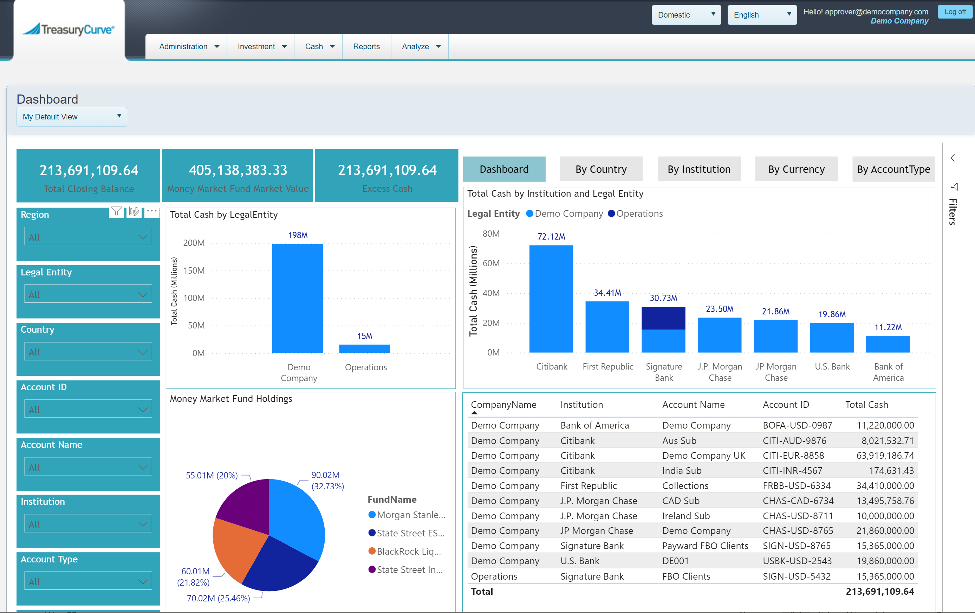

Slide 11
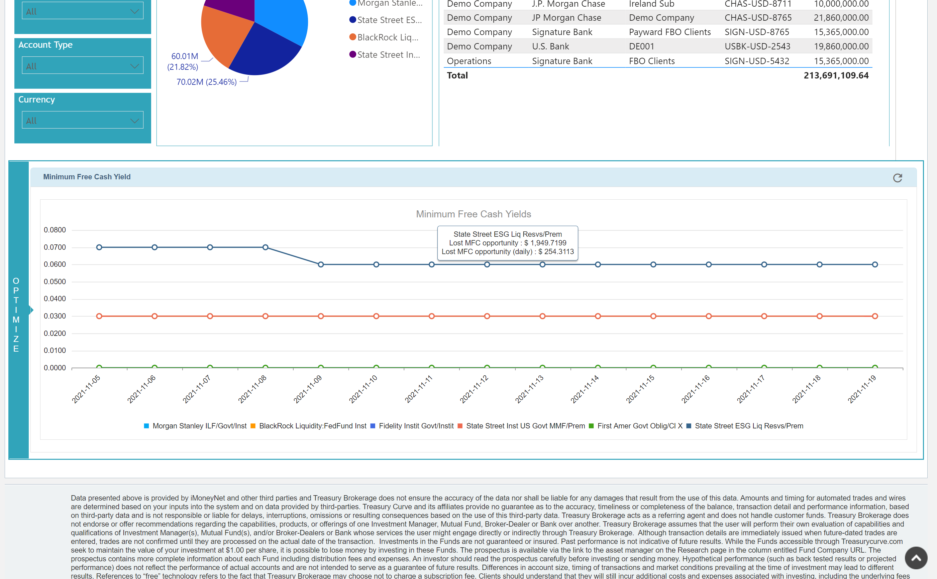

Slide 12
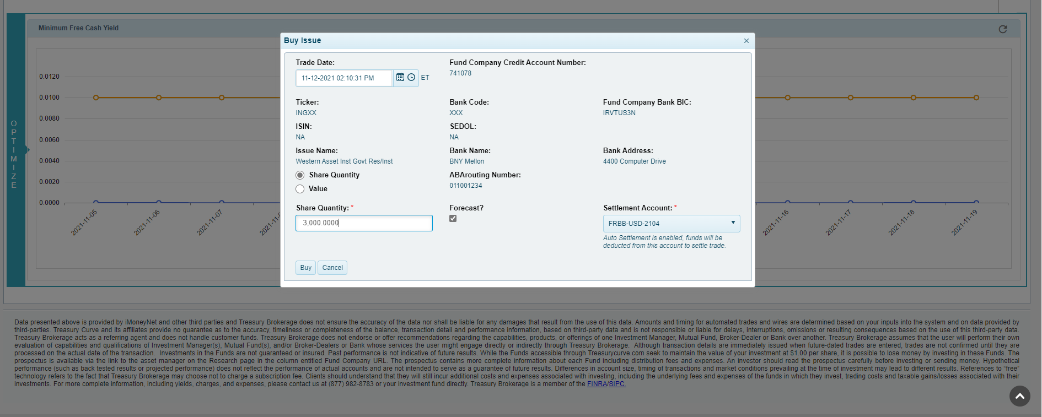

Slide 13
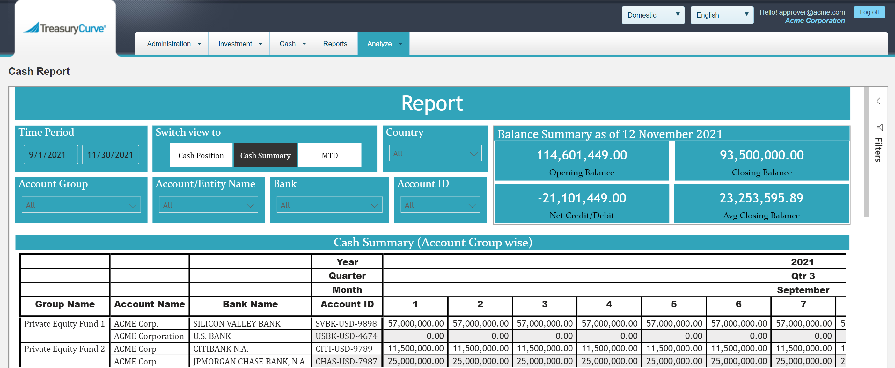

Slide 14
Key takeaways
Treasury Technology is become available to everyone
Technology Credit will make it cost efficient if not free
Banks and Fintech will provide more services at a cheap price
Taking advantage of changing technology and understanding, your options will benefit organizations
Notes:
Confirm Objectives/Priorities
Talking Points
Here are a few of the priorities I hear again and again as I talk to other finance and treasury leaders as it relates to their Treasury.
Questions to Ask
How similar are these to your goals and priorities?
What's the same?
What's missing or different in your situation?
How would you prioritize?
Transition
Okay, that's helpful. If we're going to meet these priorities, we must understand the typical challenges that are getting in the way. We see a big dilemma getting in the way for organizations who are seeking to get more value from their Treasury. It looks like this...

Slide 15
Thank You

