Slide 1

Driving Treasury Costs Down When Everything Else is Going Up
May 17, 2023

Slide 2


Meet your session host
Chelsey Kukuk
Director of P.A.C.E.
ckukuk@redbridgedta.com

Slide 3
Agenda
Establishing the Players
Understanding the Fees
Payment Strategy & Cost Optimization

Slide 4
Establishing the Players
Acquirers, Banks, Processors, Card Brands, ISOs, Gateways

Slide 5












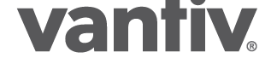














































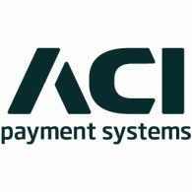
















Payment Landscape
Point of interaction
Gateways
Acquirers
Notes:
In terms of providers,
one-size doesn’t fit all

Slide 6
Cash Management Landscape
Cash/Coin
Armored Carriers
Software
Checks
Lockboxes
Check Print
EFTs
Aggregators
Integrated Service Providers
Banks leverage many third parties to process different types of payments but most of these relationships are invisible to the client.
Volumes are fed to the bank and the bank controls the overall pricing strategy to the customer.
There is a recent trend of customers forming direct relationships with 3rd parties and consolidation

Slide 7
What’s in a name?
Let’s eliminate some confusion and draw parallels between the card industry and traditional bank terminology.
 | Card Management | Cash Management
Name for corporate entity that accepts payment | Merchant | Company
Number that identifies your activity | MID | Bank Account Number
Who contracts with the corporate treasury team? | Acquirer or Acquirer/Processor ISO/Acquirer/Processor | Bank

Slide 8
Bank vs. Payment Card
 | Card Payment | Cash/Ck Payment
Who generates the statement? | Processor | Bank
Changes to contracted pricing | 1-2 times a year by card brands for interchange and also acquirers at their discretion | Bank’s discretion
Government regulations on pricing | Yes – debit and in certain countries | No
Who sets the ‘industry standard’? | Card Brands, PCI DSS, NACHA, Sponsor Banks, & Federal and State Governments | AFP, ISO20022

Slide 9
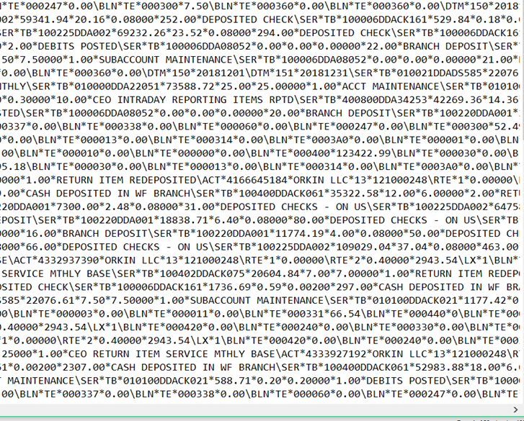

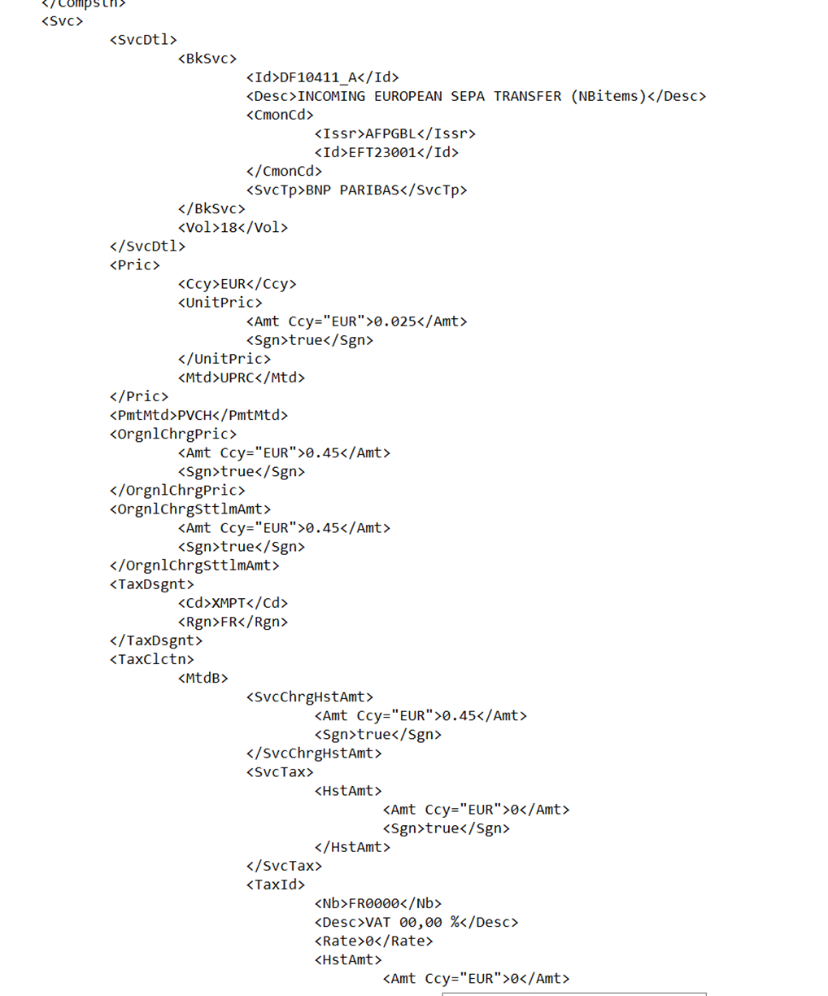
Receiving the data is not an issue on the cash side.
Industry standard electronic options exist with software to validate costs.
Understanding it is!
Excel/CSV

Slide 10
Understanding the Statement
Card
Cash Management
No industry standard PDF
No industry standard XLS
No industry standard XML
No industry standard EDI
No industry standard classification codes
Industry standard PDF format
Industry standard XML
Industry standard EDI
No industry standard XLS
Industry standard classification codes (AFP Service Codes)

Slide 11
Understanding the Fees
Interchange, Acquirer Pricing, Card Network Fees, Miscellaneous Fees
AFP Codes, Bundled Pricing, Earnings Allowance

Slide 12
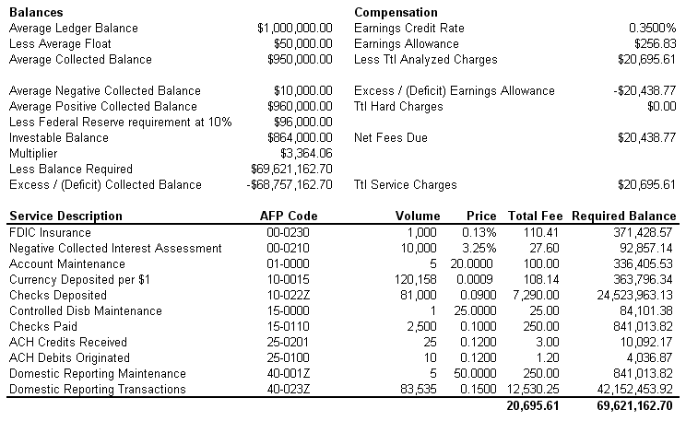
Typical Account Analysis Statement
A
C
B
D
Section A: The starting point to calculating compensation owed by the bank.
Section B: Drills into balances further, in order to arrive at the balance factor ($864,000) used in the earnings credit formula.
Section C:
  The earnings credits rate (ECR) applied to the balance factor: $864,000 * 0.0035% / 365 days * 31 days = $256.83
  The gross fees that the earnings credits will be applied to: $20,695.61
Section D: The net fees owed to the bank.

Slide 13
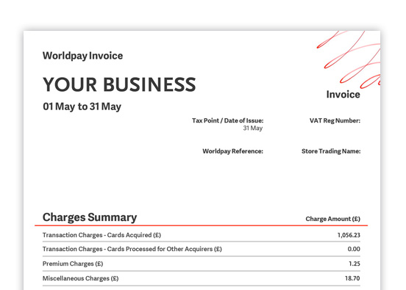
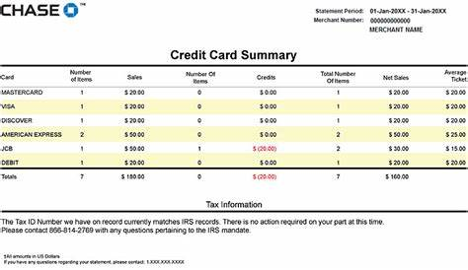
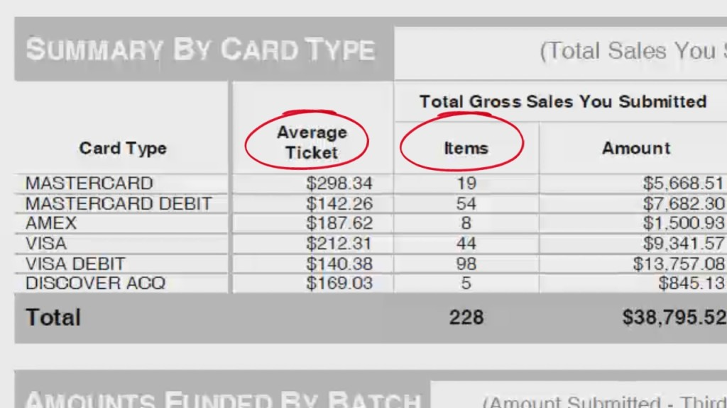
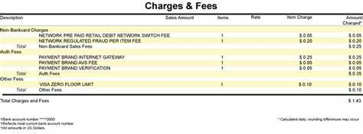
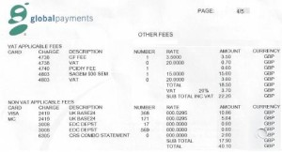
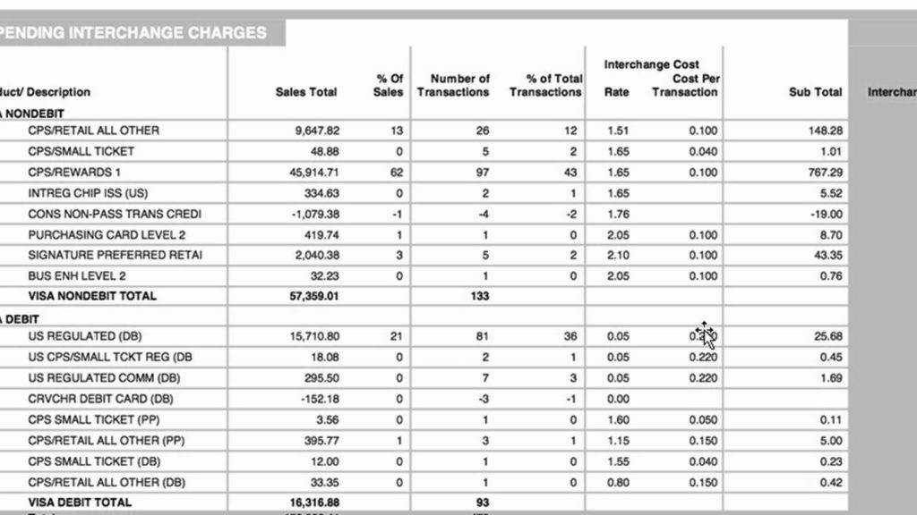
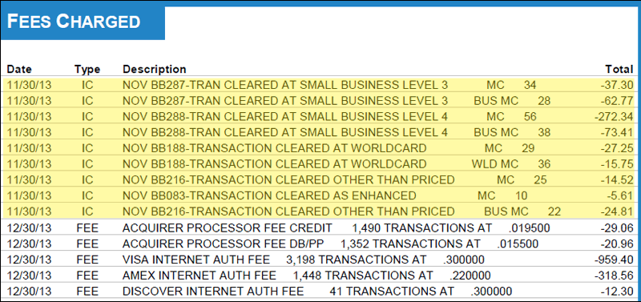
‘Typical’ Card Monthly Statement
There is NO uniform reporting standard

Slide 14
Classifying Bank Fees
Why is bank fee analysis so hard?
AFP Global Code
AFP Definition
AFP Service Name
ACT10002
General Account Activity - Debit/Credit Posting
Charge for posting a debit and/or credit to an account.
Brazil
Transaction fee
Honduras
COM ACUM.TRANSACT.AC
COM ES&CHRG TRANS.
Ireland
FTN POSTING CHARGE
NY OTHER DEBIT/CREDIT
Mexico
COM TRANS FISCAL ACC
U.K.
TRANSACTION CHARGES
U.S.A.
FTN POSTING CHARGE
NY OTHER DEBIT/CREDIT
Too many service lines
Banks identify services with cryptic proprietary names
Some banks bundle. Some don’t.
Bank mapping is old/inaccurate
Pricing proposals don’t match billing

Slide 15





Understanding the Payment Card fees
Interchange
Paid to the card issuing bank.
Pricing
Paid to the acquirer
Interchange
Transaction Fees
Total
Fees
Miscellaneous
Paid to the acquirer
Card Network Fees
Network Fees
Paid to card network for their services.
Typically, fees are very similar across networks
Miscellaneous

Slide 16
Interchange can be complicated but is formulaic
Downgrade
Base
MCC
Level II
Level III & LRG Ticket
Downgrades are transactions that fail to meet the requirements set forth by the Card Associations, they are the highest interchange rates a merchant can receive.
Base transactions are those that are fully qualified and include various categories for Card Present, Key Entry, MOTO, Card Not Present, and Ecommerce.
Merchant Category Code (MCC) transactions receive an advantageous interchange rate due to the assigned MCC.
Beyond MCC, commercial card transactions can qualify at further reduced rates depending on the amount of line-item data sent with the transaction.

Slide 17
Payment Strategy & Cost Optimization
Visibility
Accountability

Slide 18
Payment card acceptance is complex, costly, and extremely difficult for organizations to effectively navigate and proactively manage
Hundreds of Interchange Rates
1,000’s of
POS
options
Complex
cross
border fees
50+
acquirers
20+
networks
Over
100 MCC designations
250+
gateways
100+ Card issuers
PCI
compliance
requirements
EMV
compliance
1000’s of
ISO/MSP’s
Contract terms &
SLA’s

Slide 19
Why is capturing merchant data important and what insights will it provide?
Visibility
Accountability
Maximization of Efficiencies
Statement descriptions vary widely from provider to provider;
Extensive amounts of data to search through and understand;
Manual data entry and time;
Statement data availability and formats;
Collection of statement data from all parties involved;
Lack of knowledge surrounding merchant service provider fee presentations and published network fees.
Time consuming and error prone analysis that lacks standardized format;
Difficulty connecting and quantifying fee items across statements – ripple effects;
Insufficient information to accurately benchmark current costs, set targets, and evaluate proposals;
Unfamiliarity with current best practices in service provider negotiations, which is key for ensuring maximum flexibility for decision making.
Sub-optimal performance from incomplete identification of all core payment strategy opportunities and error corrections;
Recognizing all approaches to optimization, including redefining acceptance channels and exposure to new technology;
Ensuring prices offered are in-line with market and appropriate for services utilized;
Long term monitoring to keep mediated structure and practices intact.

Slide 20
Data must be captured effectively in order to be relevant to the business

Slide 21

Multiple views provide the best picture…global, regional and individual levels

Slide 22
Utilizing effective rates as a tool
Effective rates can be a good tool for evaluating the effectiveness of the organization’s current payment strategy
They can also be used for predictive analytics and modeling purposes
Effective rate KPI’s include, but are not limited to:
  Payment type
  Payment method
  Payment channel
  Card brand
  Card type
  Interchange level qualification
  Brand fees
  Assessments
  Transaction fees

Slide 23

Managing relationships by leveraging data
Harnessing merchant data gives you insights into your acceptance environment to better facilitate vendor and partner relationships
With the right data organizations can leverage routing strategies, preferences and maximize card brand value exchange incentives

Slide 24
Managing interchange
Volume by Interchange Category
Interchange accounts for over 85% of an organization’s acceptance costs, in most cases
With the right data, these fees can be optimized and proactively managed in order to prevent against unnecessary interchange related expenses
Ability to drill down to a granular level is key
Cost by Interchange Category

Slide 25

How to measure your success….
Bank Fees
Card Fees
Cost per check
Cost per $ deposited
Cost per ACH. Per wire.
Punitive Charges
Cost per account
Volume of each payment type
Manual fees
Average Ticket
Effective rate
Chargebacks
Recovery Rate

Slide 26
Final Takeaways
Lock in pricing now will help stem the ultimate cost of inflation over time and provide stability in your costs.
Identify key metrics that can help you prove your success and build a culture of internal and external accountability.
Having the conversation of cash and card together can help the bank make better cases internally.

